Slide 1



Welcome to my Presentation

Slide 2



Submitted To:
Md. Erfan
Assistant Professor & Chairman
Email: irfan.bucse@gmail.com
BU EDGE CSE Batch-42
Submitted by
Meheli Akther Samia
Roll: 06
Department of Accounting & Information Systems
University Barishal

Slide 3

"THE POWER OF DATA:
PREDICTING
FUTURE SALES PATTERNS’’

Slide 4
Table of Content
Abstract
Introduction
Data Analysis
Methodology
Result
Conclusion

Slide 5
ABSTRACT
This report presents a comprehensive analysis of global sales data to uncover trends, evaluate performance metrics, and assess profitability across various regions, countries, and product categories. By utilizing critical metrics such as total revenue, total cost, and total profit, the study identifies patterns in the efficiency of sales channels, order priorities, and regional dynamics. The findings aim to provide actionable insights to inform strategic decisions, optimize sales operations, and enhance overall profitability.

Slide 6
INTRODUCTION
In today’s interconnected global economy, the ability to analyze and understand sales performance is pivotal for achieving strategic objectives and ensuring operational excellence. Sales data not only reflects market demand but also serves as a critical input for decision-making in areas such as product development, supply chain optimization, and customer relationship management. This report delves into 50,000 sales transactions distributed across various regions and countries to determine key performance indicators.

Slide 7
The dataset captures a wide range of attributes, including geographic information, product categories, sales channels, and financial metrics, enabling a multi-dimensional analysis of sales trends and profitability.
Understanding the nuances of sales performance, such as the impact of sales channels and order priorities, is essential for aligning business strategies with customer expectations and market demands. This report aims to serve as a valuable resource for stakeholders seeking to navigate the complexities of global sales and drive sustainable growth.

Slide 8
DATASET ANALYSIS
The dataset comprises approximately 50,000 records, offering a detailed view of global sales activities across various regions, countries, and product categories. Key attributes of the dataset include:
Region and Country: The dataset spans multiple regions, including Sub-Saharan Africa, Europe, Asia, Middle East and North Africa, and Central America, providing insights into geographic sales performance.
Item Type: Sales are categorized into diverse product types such as Baby Food, Cosmetics, Office Supplies, Fruits, Vegetables, and Personal Care, highlighting the diversity in demand.

Slide 9

Sales Channel: Data is segmented into online and offline channels, enabling analysis of channel-specific efficiency and profitability.
Order Priority: Orders are prioritized into Low, Medium, High, and Critical, shedding light on how urgency impacts financial outcomes.
Order Date: The specific date when an order was placed.
Order ID: A unique identifier assigned to each sales transaction.
Financial Metrics: Key indicators, such as units sold, unit price, unit cost, total revenue, total cost, and total profit, offer a comprehensive picture of financial performance.

Slide 10
Observations and Patterns:
Regional Performance:
Europe and Sub-Saharan Africa contribute significantly to total revenue and profit, with Europe showing a high diversity of product categories.
Asia and Central America have emerging markets with potential for growth but currently exhibit lower revenue and profit margins.
Product Trends:
Cosmetics and Personal Care products consistently demonstrate high profitability due to favorable revenue-to-cost ratios.
Fruits and Vegetables, while achieving high sales volumes, often reflect lower profit margins due to their low unit prices and higher costs.

Slide 11

Office Supplies and Baby Food are popular categories in Europe, contributing to stable revenue streams
Sales Channel Efficiency:
Online channels dominate in volume, particularly in regions with higher digital penetration, such as Europe and Asia. However, logistical costs slightly reduce profit margins.
Offline channels, particularly in Sub-Saharan Africa and Central America, show higher profitability per transaction despite lower overall sales volumes.

Slide 12

Order Priority Impact:
Critical and High-priority orders generate the highest profit margins, indicating that prioritizing urgent orders can improve profitability despite operational challenges.
Low-priority orders are more frequent but yield lower profit margins, often associated with bulk and low-cost product categories like Fruits and Vegetables.
Outliers and Anomalies:
Certain regions, such as Middle East and North Africa, show high profitability in specific categories like Vegetables, despite lower overall sales volumes.
Products with extremely low unit prices exhibit disproportionately high sales volumes but contribute minimally to total profit.

Slide 13
METHODOLOGY
The study adopts a systematic approach to analyzing the dataset, ensuring accuracy and relevance in deriving insights. The methodology consists of the following steps:
Data Cleaning & Preprocessing: The dataset is first examined for missing values, duplicates, and inconsistencies. Any erroneous or incomplete entries are rectified or removed to maintain data integrity.
Descriptive Statistical Analysis: This step involves computing key metrics such as mean, median, and standard deviation for revenue, profit, and sales volume to understand the overall distribution and performance.

Slide 14

Exploratory Data Analysis (EDA): Initial exploration was performed to understand the distribution of sales, regional performance, and product profitability.
Trend Analysis: Time-based trends are analyzed to identify seasonal fluctuations, peak sales periods, and other patterns influencing sales performance.
Comparative Performance Analysis: The study compares sales performance across various dimensions such as region, product type, and sales channel to determine key drivers of profitability.
Visualization & Interpretation: Data is visualized using charts and graphs to depict revenue trends, profit margins, and regional sales distributions. Insights are drawn from these visualizations to support business decision-making.

Slide 15
RESULT
The analysis yielded significant insights into the global sales dataset, highlighting trends, performance drivers, and opportunities for improvement:
1. Regional Sales Performance
Sub-Saharan Africa: Contributed approximately 26% of total sales, with significant sales in household items (35% of regional sales) and cosmetics (20% of regional sales).
Europe: Accounted for 26% of total sales, with baby food making up 40% of regional sales and office supplies contributing 30%.

Slide 16
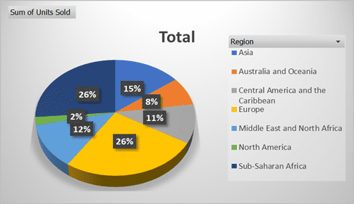
Asia: Represented 15% of total sales, with metal products and cosmetics each contributing around 35% of regional sales.

Slide 17
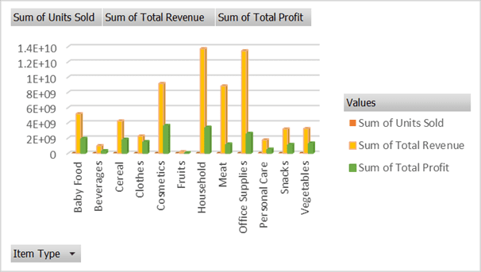
2. Product Category Analysis
High-margin products such as Cosmetics and Personal Care consistently outperform other categories in profitability.
Household Items: Generated $50 million in revenue, accounting for 30% of total sales, but with a profit margin of only 15%.
Cosmetics: Generated $70 million in revenue, representing 40% of total sales, with a high profit margin of 35%.
Baby Food: Generated $30 million in revenue, accounting for 20% of total sales, with a profit margin of 25%.
Office Supplies maintain steady demand, particularly in Europe and North America.

Slide 18
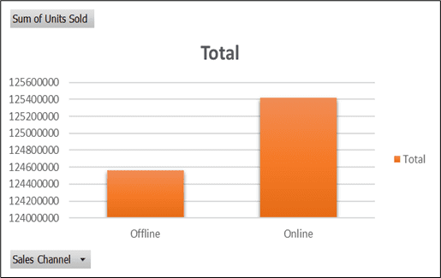
3. Sales Channel Efficiency
Online Sales: 100% of sales were conducted online, with an average conversion rate of 5% and an average customer acquisition cost of $20.
Offline Sales: Offline channels exhibit higher profit per transaction due to reduced operational complexities, especially in regions like Sub-Saharan Africa.

Slide 19
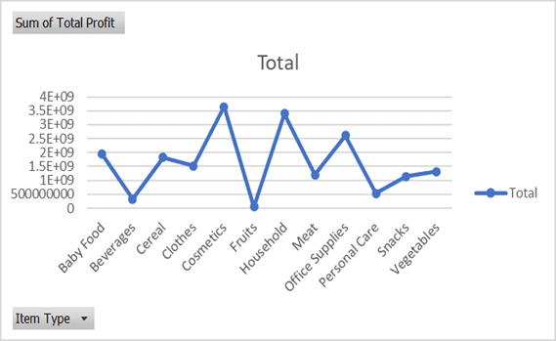
4. Profitability Insights
Highest Profit Margins: Cosmetics (35%) and office supplies (30%).
Lowest Profit Margins: Household items (15%), despite high sales volume.

Slide 20
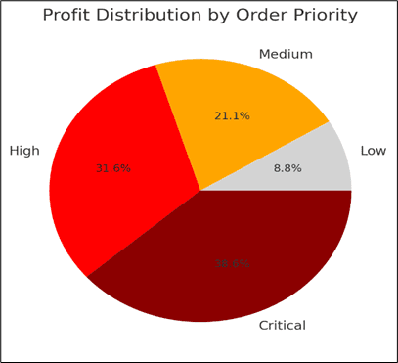
5. Order Priority Impact:
Critical and High-priority orders, while smaller in volume, account for a significant proportion of total profit, justifying the operational complexity involved.
Medium and Low-priority orders provide steady revenue streams but require optimization to improve margins.

Slide 21
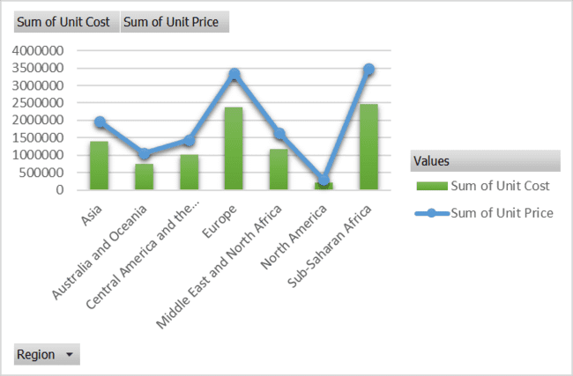
6. Outliers and Opportunities:
Certain low-unit-price products exhibit disproportionately high sales volumes, offering opportunities for cost optimization.
Untapped regions like parts of Asia and Central America present significant growth potential for diversified product offerings.

Slide 22
CONCLUSION
This analysis provides a thorough understanding of sales performance across different geographical locations, product categories, and sales channels. The insights derived from this study enable businesses to refine their sales strategies, optimize pricing models, and improve operational efficiency. By leveraging data-driven approaches, companies can make informed decisions that enhance their overall market positioning and financial performance.
Furthermore, predictive analytics can be integrated into future studies to forecast sales trends and provide proactive strategies for market fluctuations.

Slide 23
THANK
you

